Slide 1
E-LEARNING
STUDENT NAME : NASIR ASHRAF
UNIVERSITY ROLL NO :10900117130

Slide 2
CONTNENT
Introduction
Objective
Front Panel -
Using Front End Technologies
Web Panel -
Back End - Laravel
Feasibility
Methodology/planning of work
Work Flow Diagram
Modules Snapshots
Facilities Required for Proposed Work
Conclusion
Bibliography

Slide 3
INTRODUCTION TO E-LEARNING

Slide 4
Introduction
The E-Learning system it is an online system where Users can access to any study related material online anywhere and any mean time.
This system provides the online e-books, previous years question papers, online video lectures for any subject according to their need.
This system provides the one-to-one interaction and thus by this all it proves it is user-friendly.
E-Learning leads to error free, reliable and fast system.
This system can be useful for any education sector and other organizations in the line learning.

Slide 5
OBJECTIVE
Refined Content
Development of an instructional strategy
Selection of mode of delivery
Student assessment and evaluation
Expected learning outcomes

Slide 6
FRONT END
HTML
JavaScript
CSS
Bootstrap
JQuery

Slide 7
HTML
HTML is a hypertext markup language which is, in reality, a spinal cord of any website.
Any website can’t be structured without the knowledge of HTML.
If we make our web page only with the help of HTML, then we can’t add many of the effective features in a web page, for making a web page more effective we use various platforms such as static and dynamics methods.
We are using this language to make our web pages more effective as well as interactive for users to understand.
To make our web pages dynamic we are using JavaScript and XML.

Slide 8
JAVASCRIPT
JavaScript is the most famous scripting languages of all time. JavaScript is a Scripting Language of World Wide Web.
The main usage of JavaScript is to add various Web function, validations, detections, a creation of cookies and so on.
JavaScript is the best scripting languages and that is why it is adopted by almost all browsers.
JavaScript is considered the most powerful scripting languages in present use.
It is used for the client -side web development. JavaScript is used to make pages more interactive.

Slide 9
CSS
CSS in PHP Stands for (Cascading Style Sheet).
Cascading style sheets are used to format the layout of Web pages.
They can be used to define way of writing or style, size of various table, and other aspects of Web pages that previously could only be defined in a static page's HTML.
The main work of CSS is to separate content of a web document (written in any markup language) that is written using Cascading Style Sheets.
It gives the option of selecting various style schemes and rules according to the necessity.

Slide 10
BOOTSTRAP
Bootstrap is a free front-end framework for faster and easier web development.
Bootstrap includes HTML and CSS based design templates for typography, forms, buttons, tables, navigation, modals, image carousels and many other, as well as optional JavaScript plugins.
Bootstrap also gives you the ability to easily create responsive designs.
Faster and Easier Web Development.
It creates Responsive Web-pages and It designed to be responsive to mobile devices too.

Slide 11
JQUERY
jQuery is a fast, small, and feature-rich JavaScript library.
It makes things like HTML document traversal and manipulation, event handling, animation.
jQuery greatly simplifies JavaScript programming.
jQuery is used by 73% of the 10 million most popular websites.
jQuery's syntax is designed to make it easier to navigate a document.

Slide 12
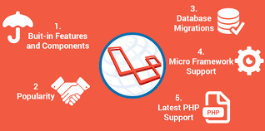
BACKEND
Laravel was created by Taylor Otwell.
Laravel is a PHP based web-framework.
Laravel is one of the open-source php frameworks.
Laravel is a web application framework with expressive, elegant syntax.

Slide 13
FEASIBILITY
A feasibility study is an analysis that takes all of a project's relevant factors into account—including economic, technical, legal, and scheduling considerations—to ascertain the likelihood of completing the project successfully.
TYPES :-
Technical
Economic
Operational

Slide 14
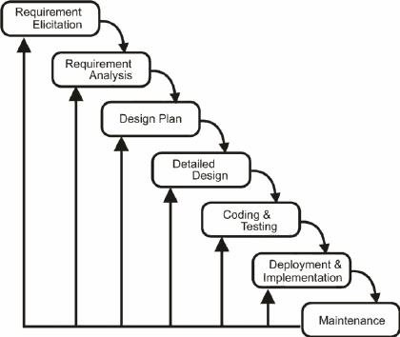
METHODOLOGY/PLANNING OF WORK

Slide 15
WORK FLOW DIAGRAM
Check Role of Admin
Admin
Login
Add Blogs
Add Video Sessions
Check
Credentials
Modules
Add Question Papers
Add E-Books

Slide 16
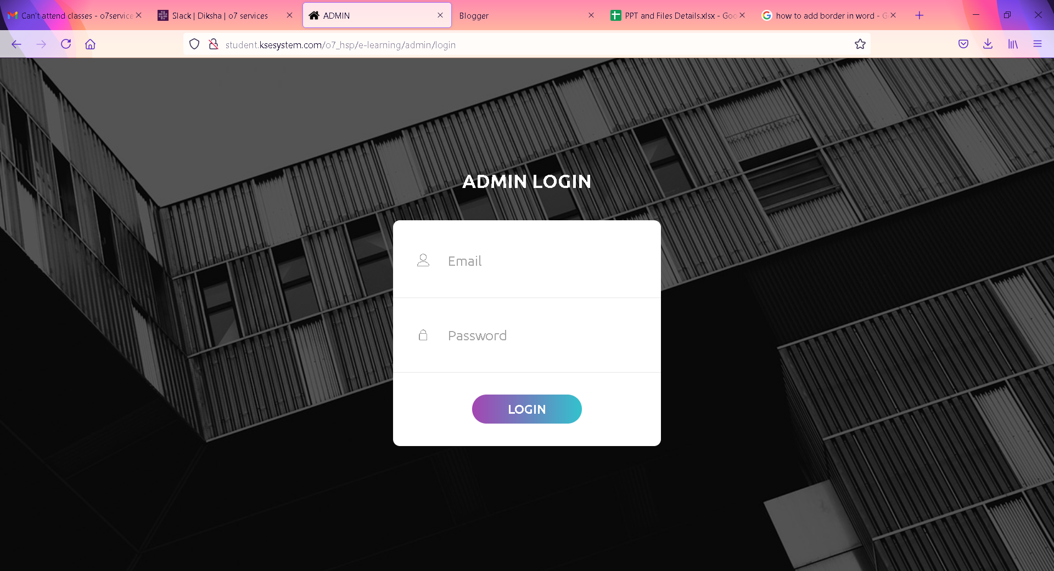
MODULES SNAPSHOTS
ADMIN LOGIN PAGE

Slide 17
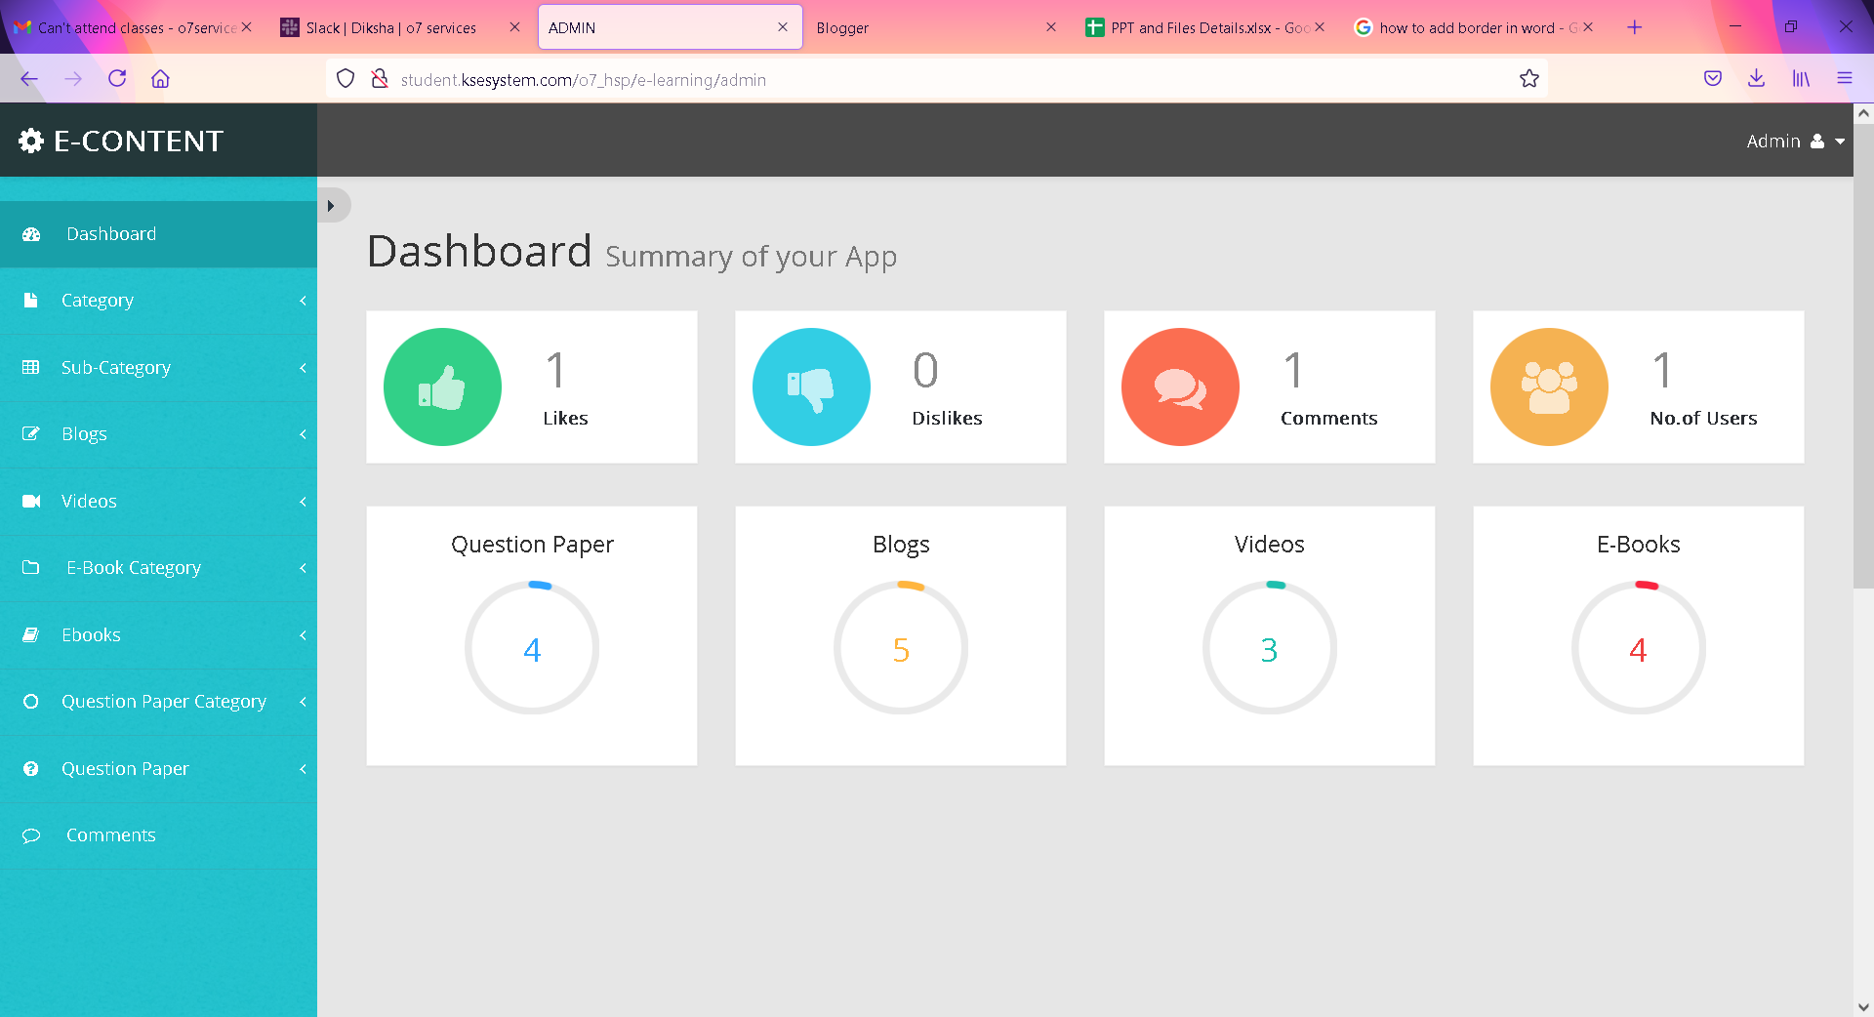
ADMIN DASHBOARD

Slide 18
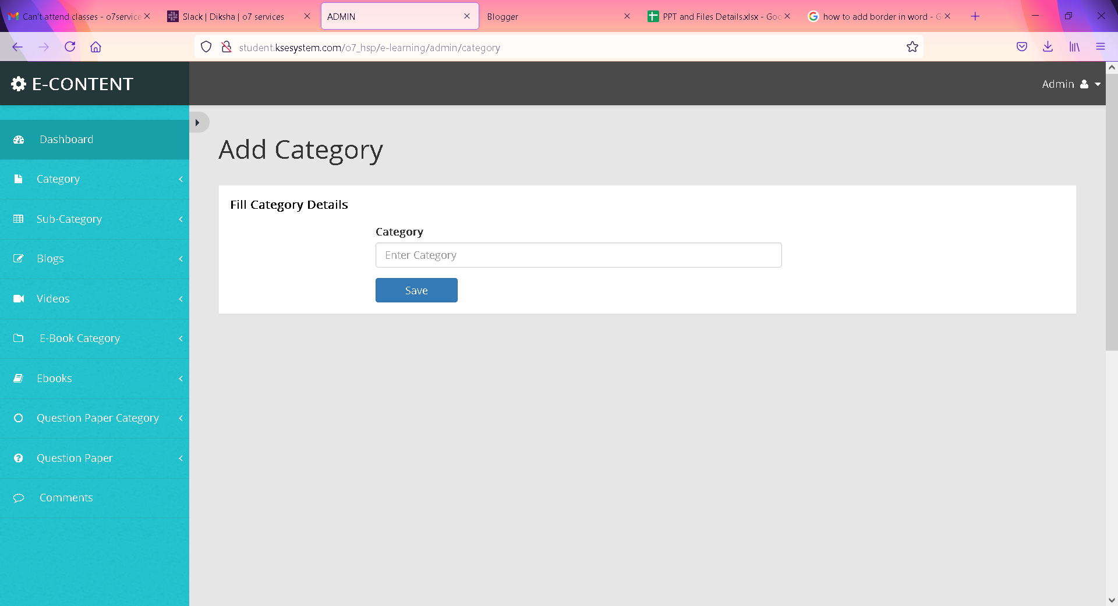
ADD CATEGORY

Slide 19
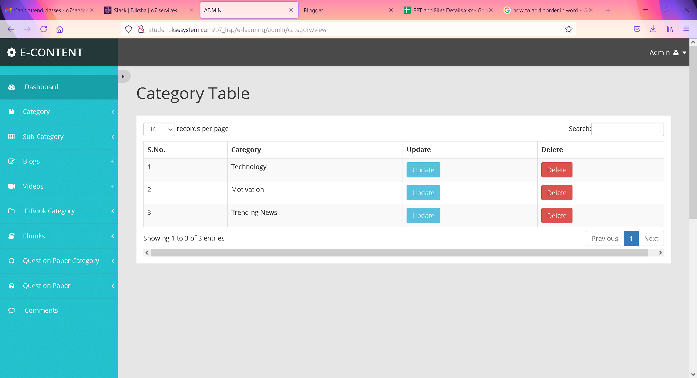
VIEW CATEGORY

Slide 20
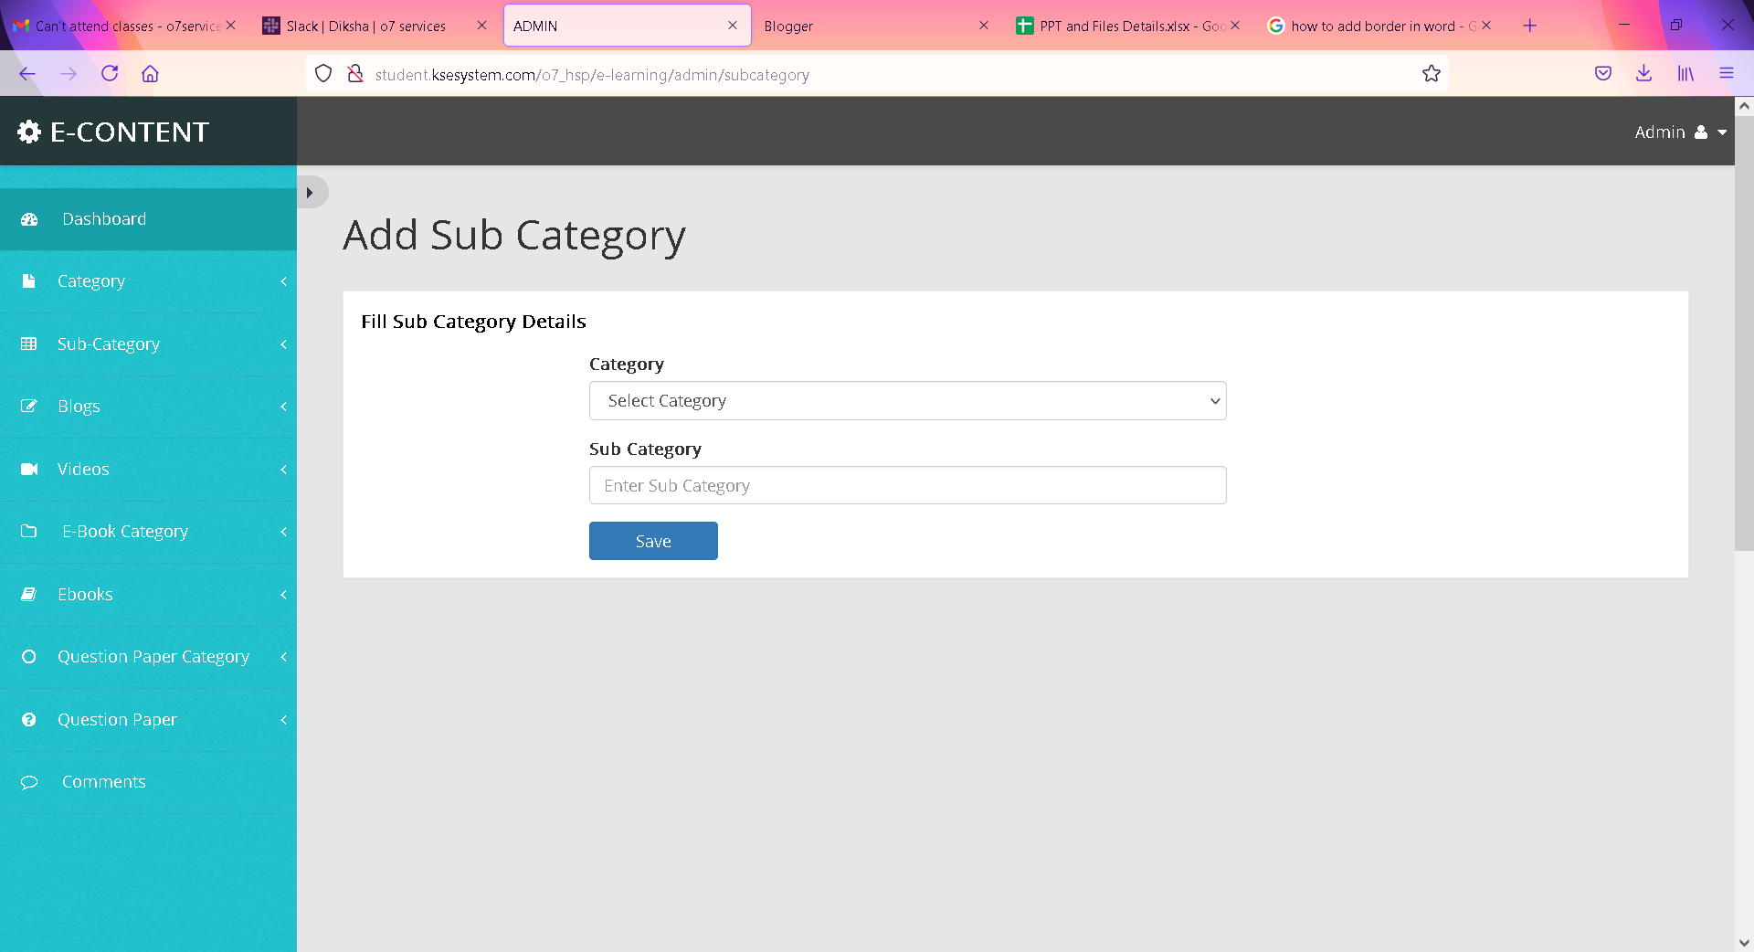
ADD SUB-CATEGORY

Slide 21
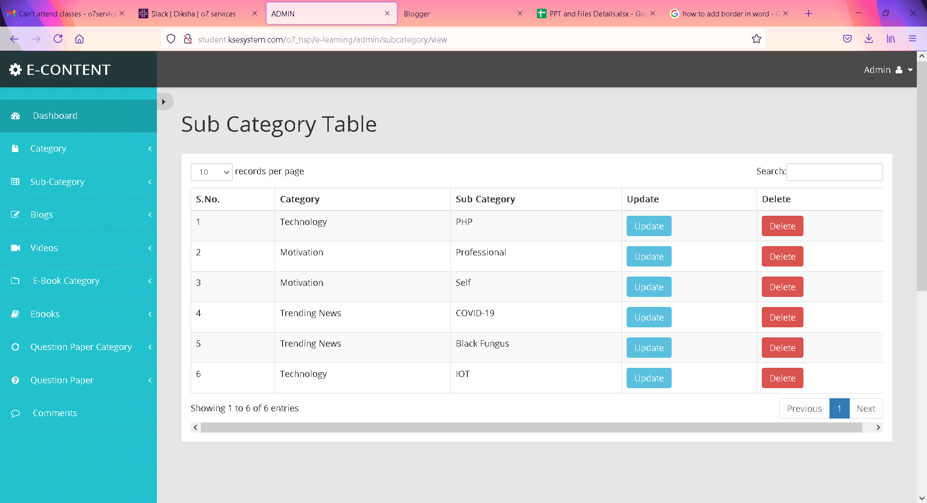
View SUB-CATEGORY

Slide 22
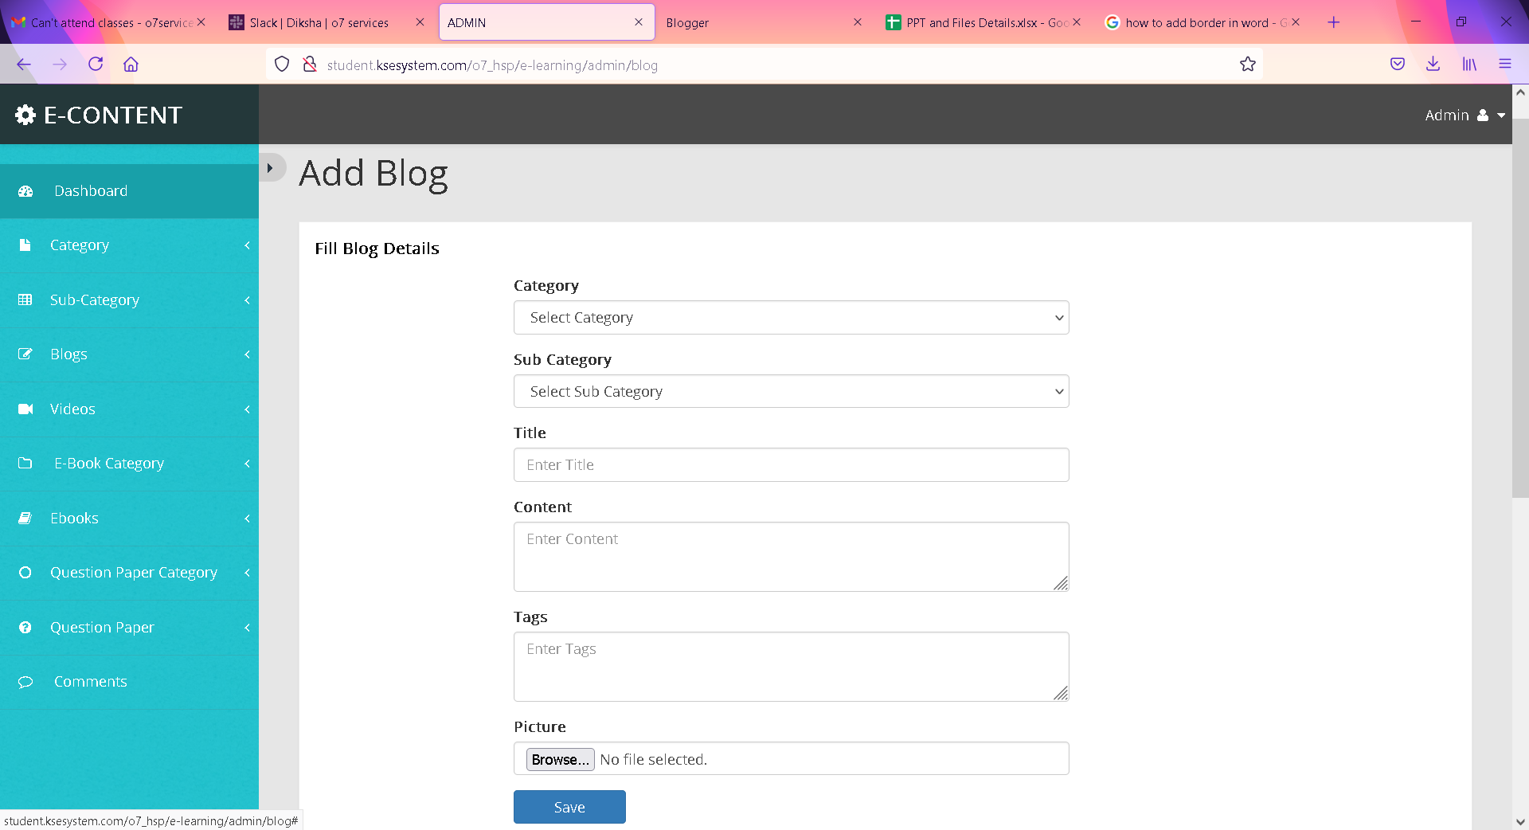
ADD BLOG

Slide 23
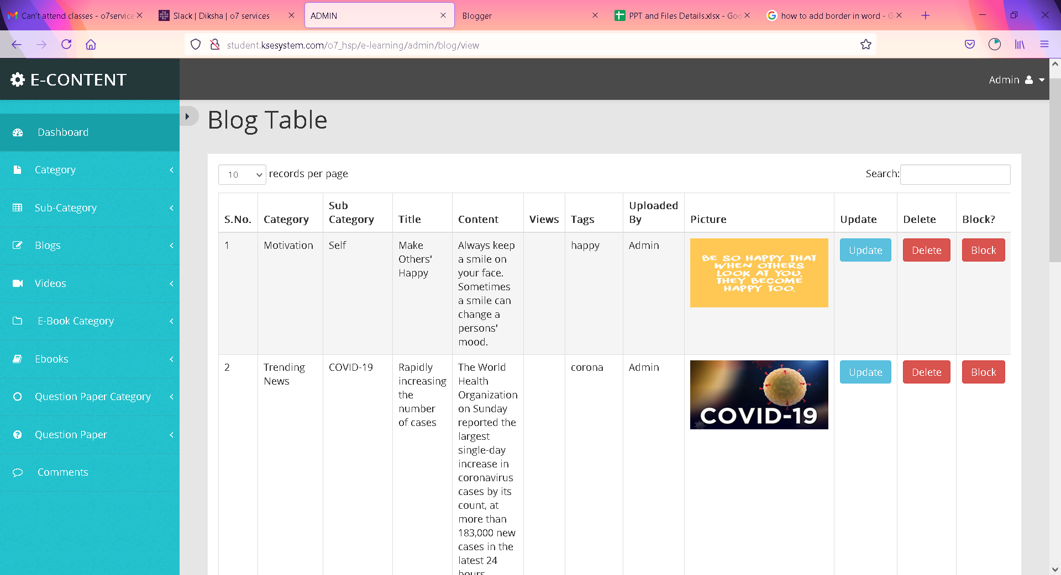
VIEW BLOG

Slide 24
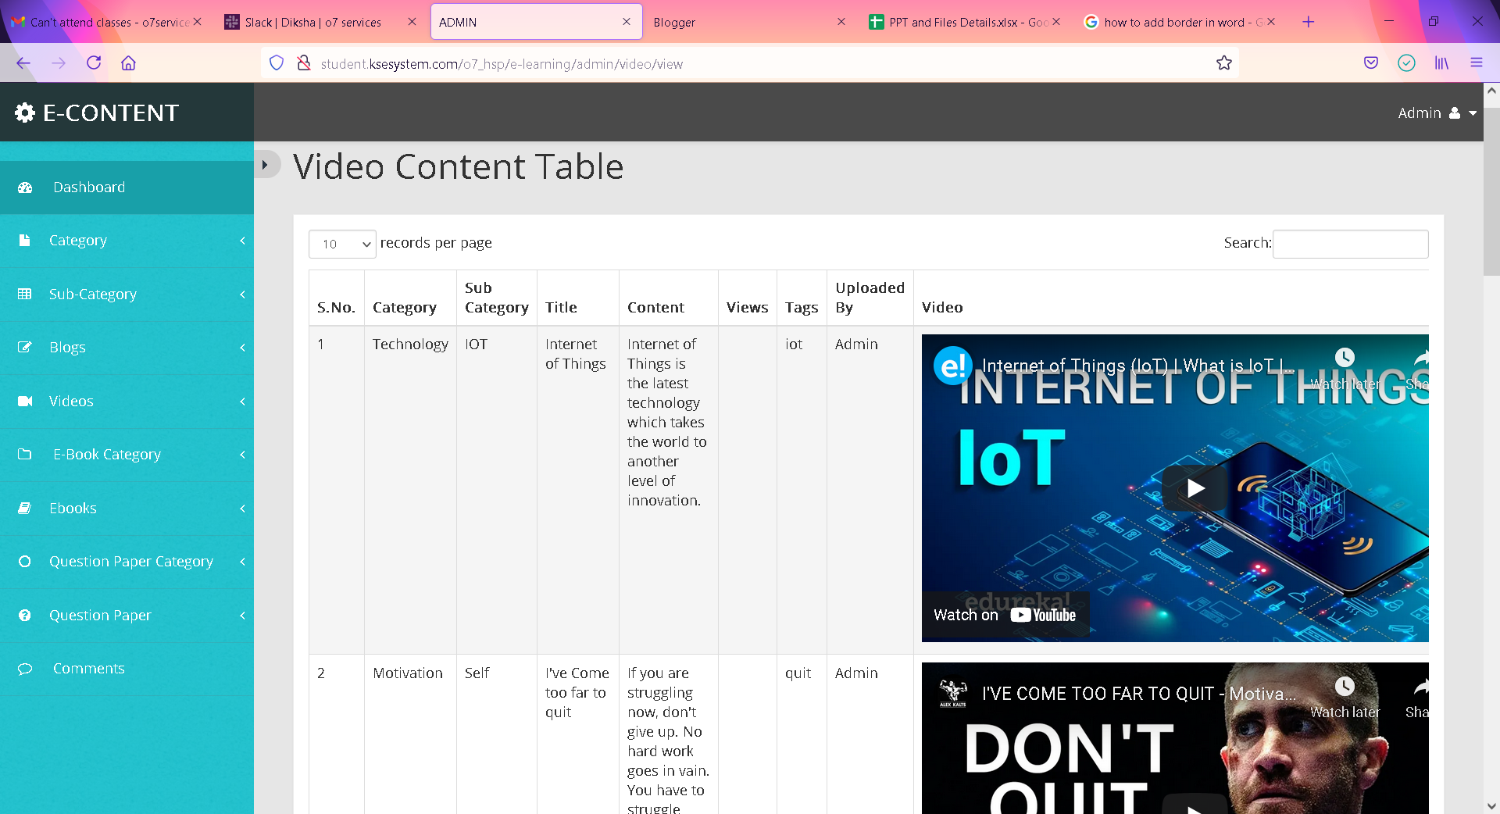
VIEW VIDEO CONTENT

Slide 25
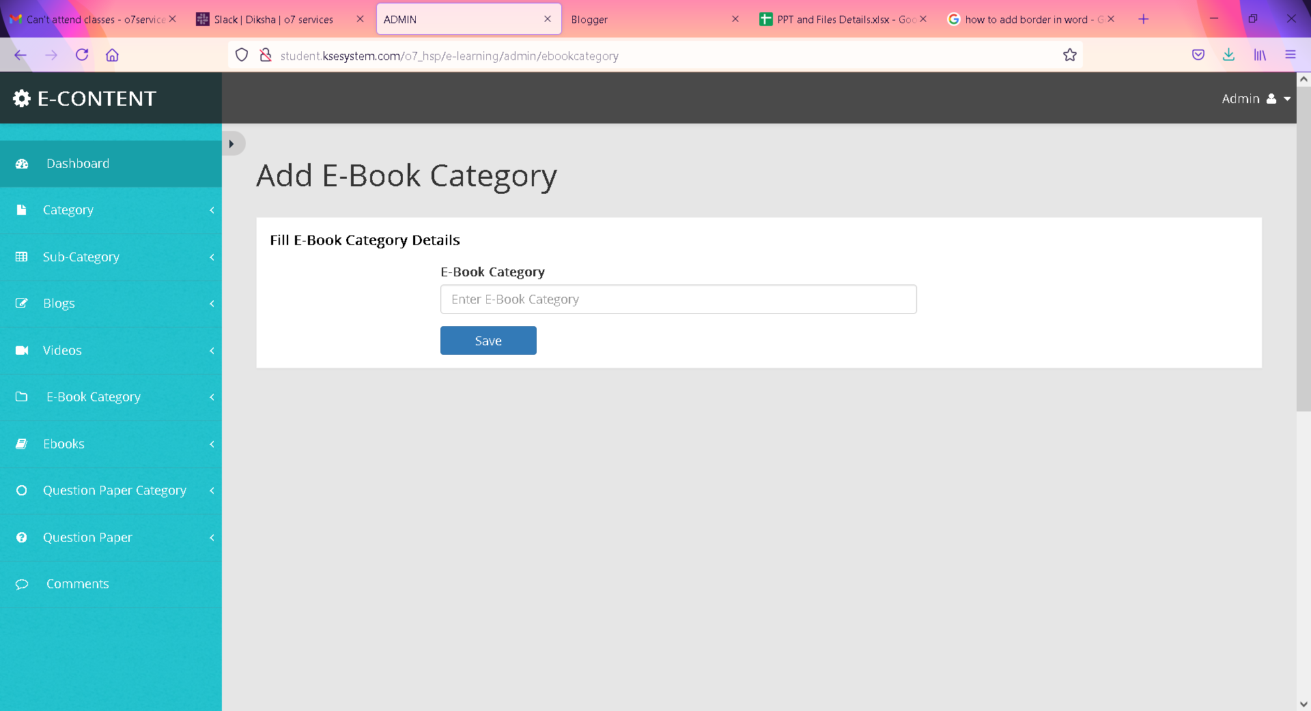
ADD E-BOOK CATEGORY

Slide 26
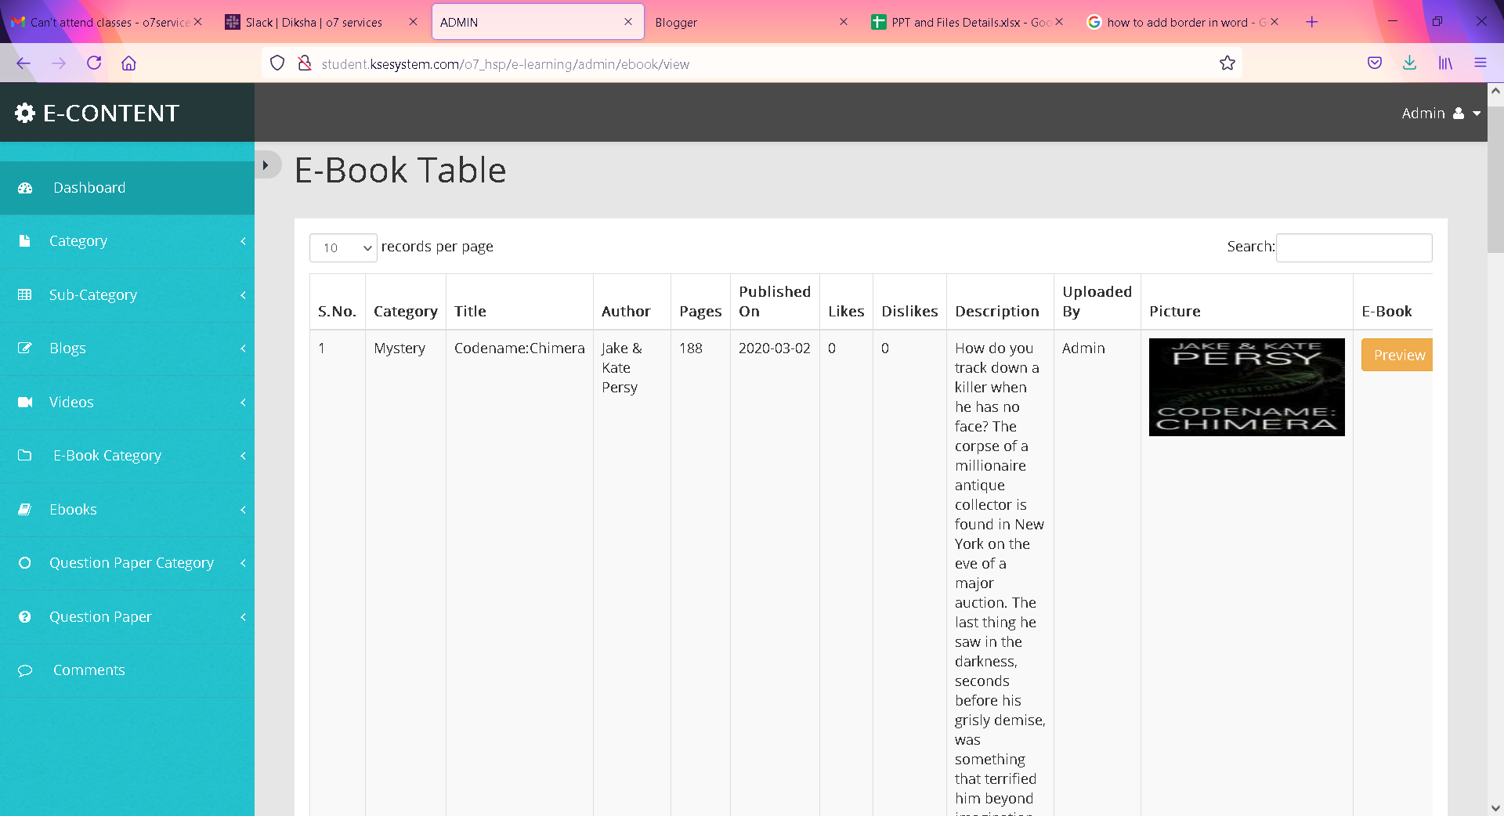
VIEW E-BOOK CATEGORY

Slide 27
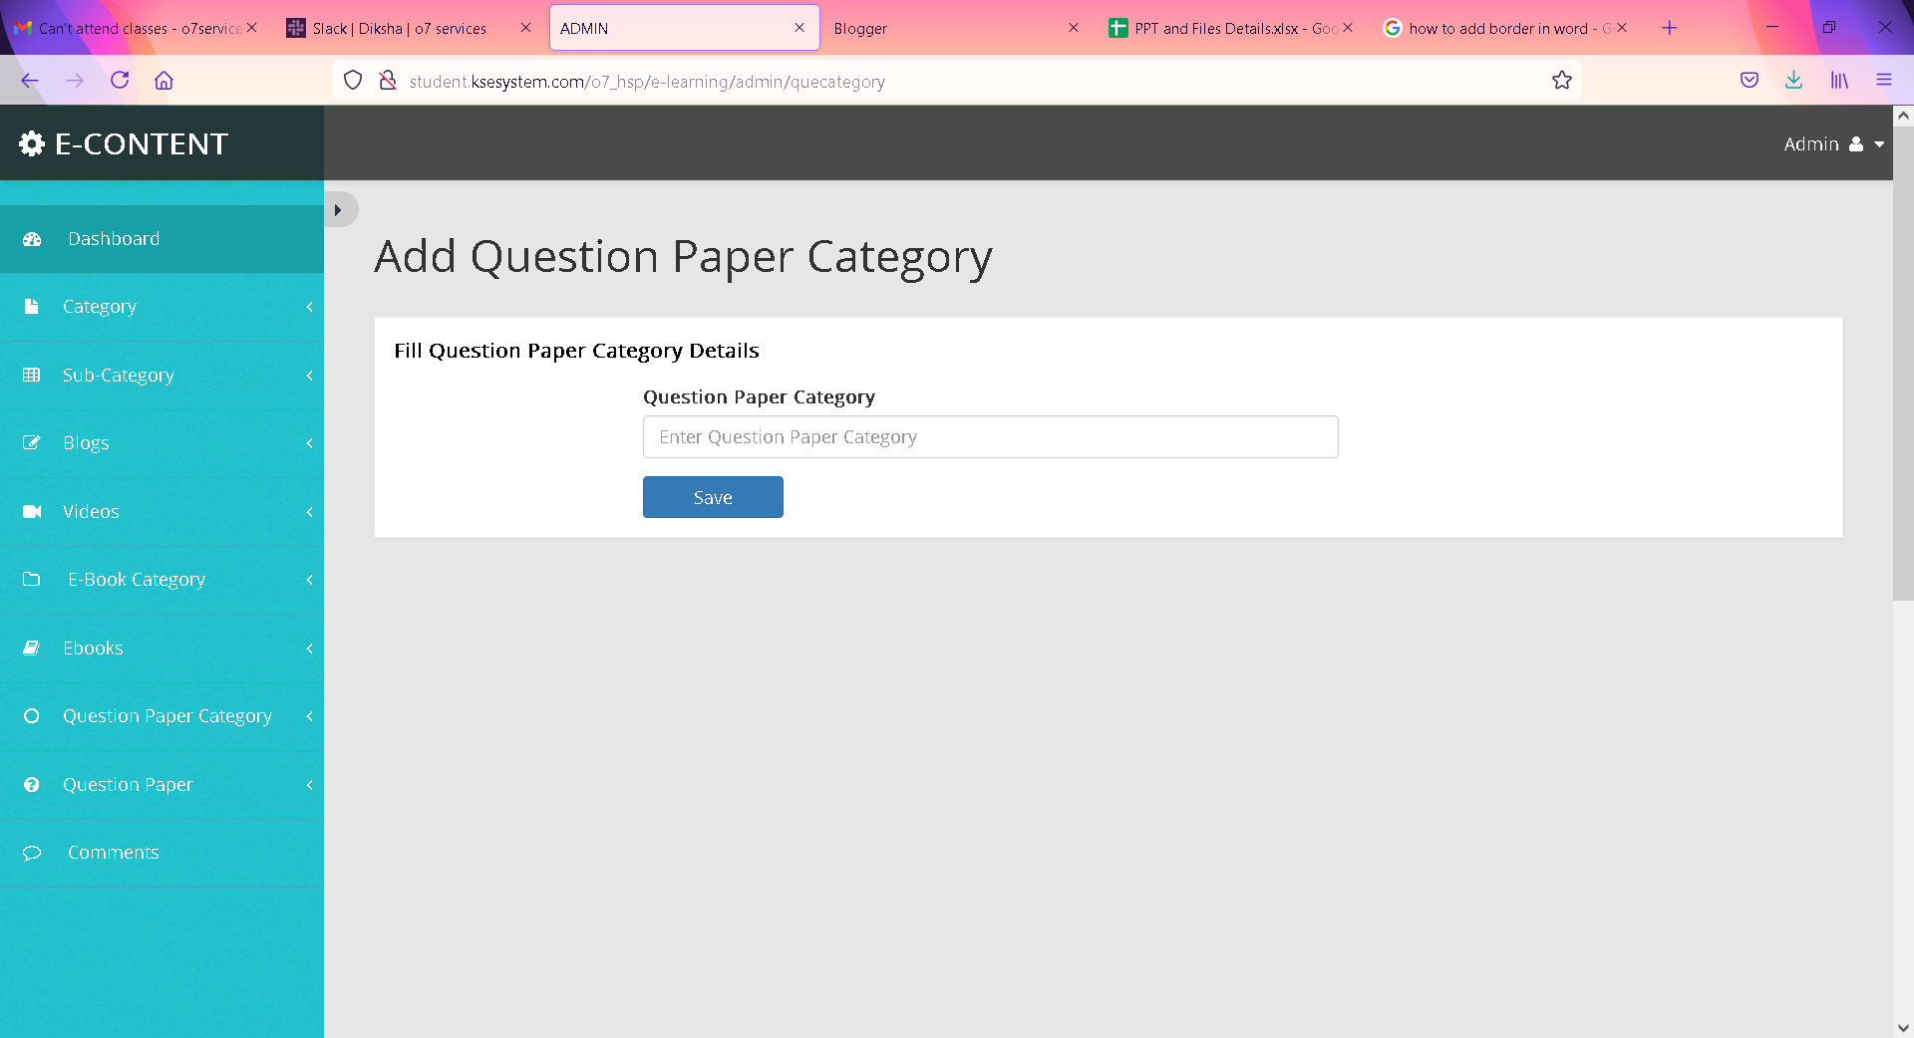
ADD QUESTION PAPER CATEGORY

Slide 28
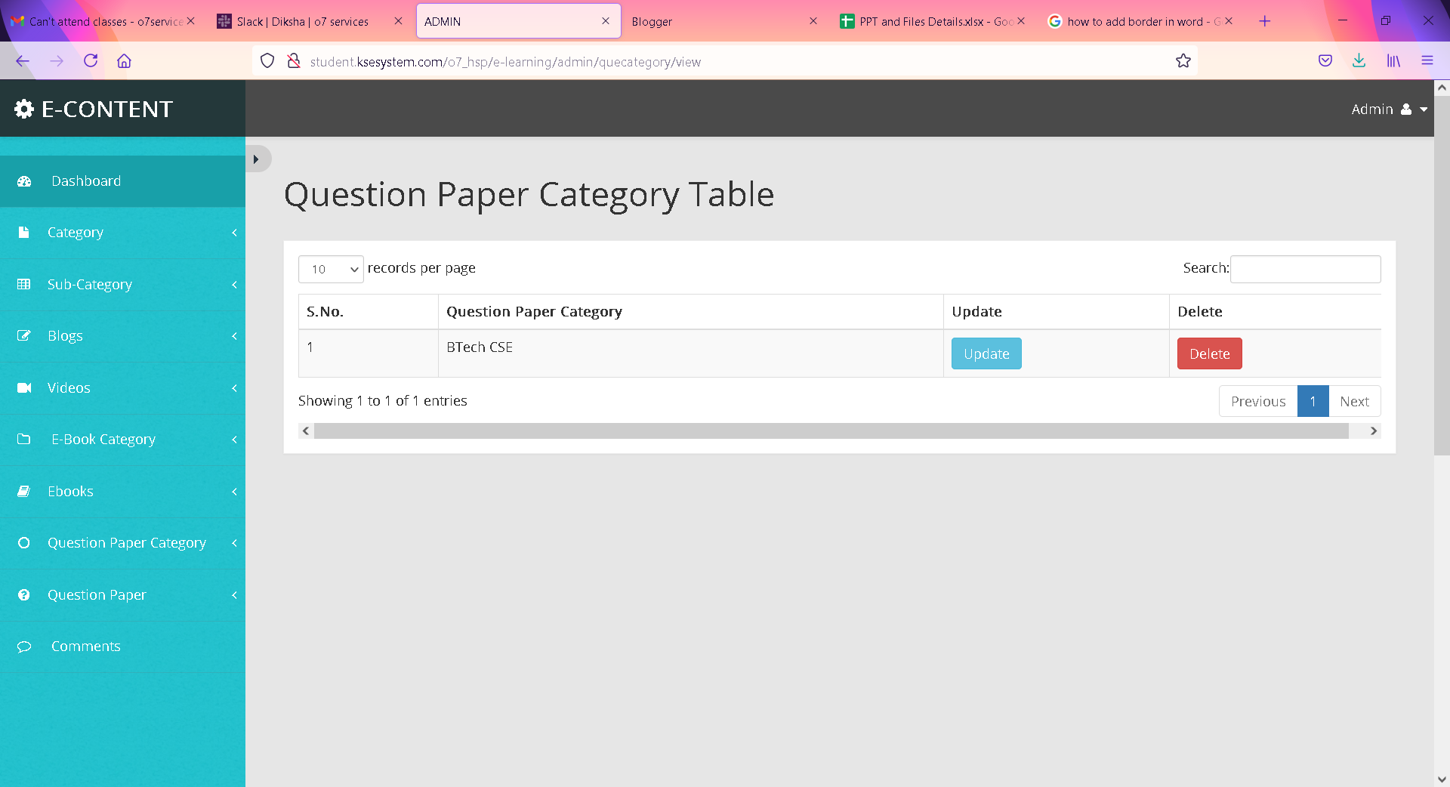
VIEW QUESTION PAPER CATEGORY

Slide 29
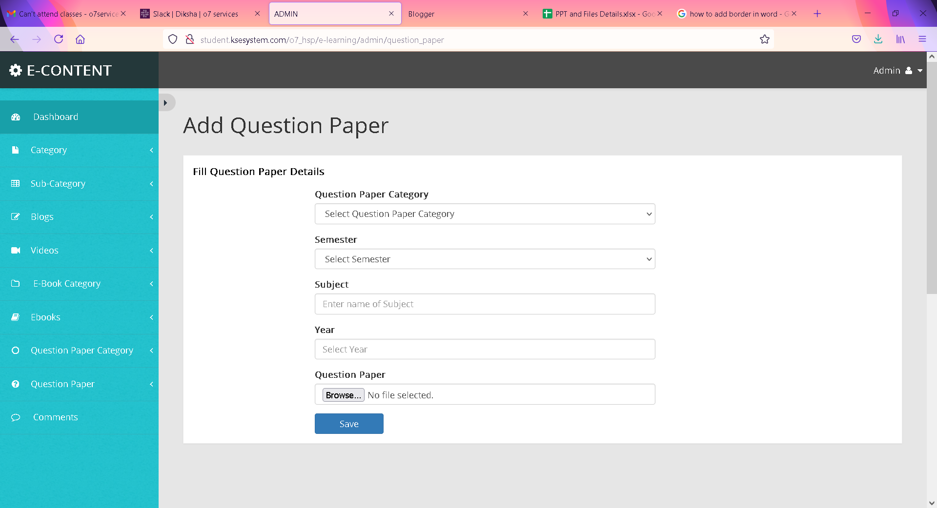
ADD QUESTION PAPER

Slide 30
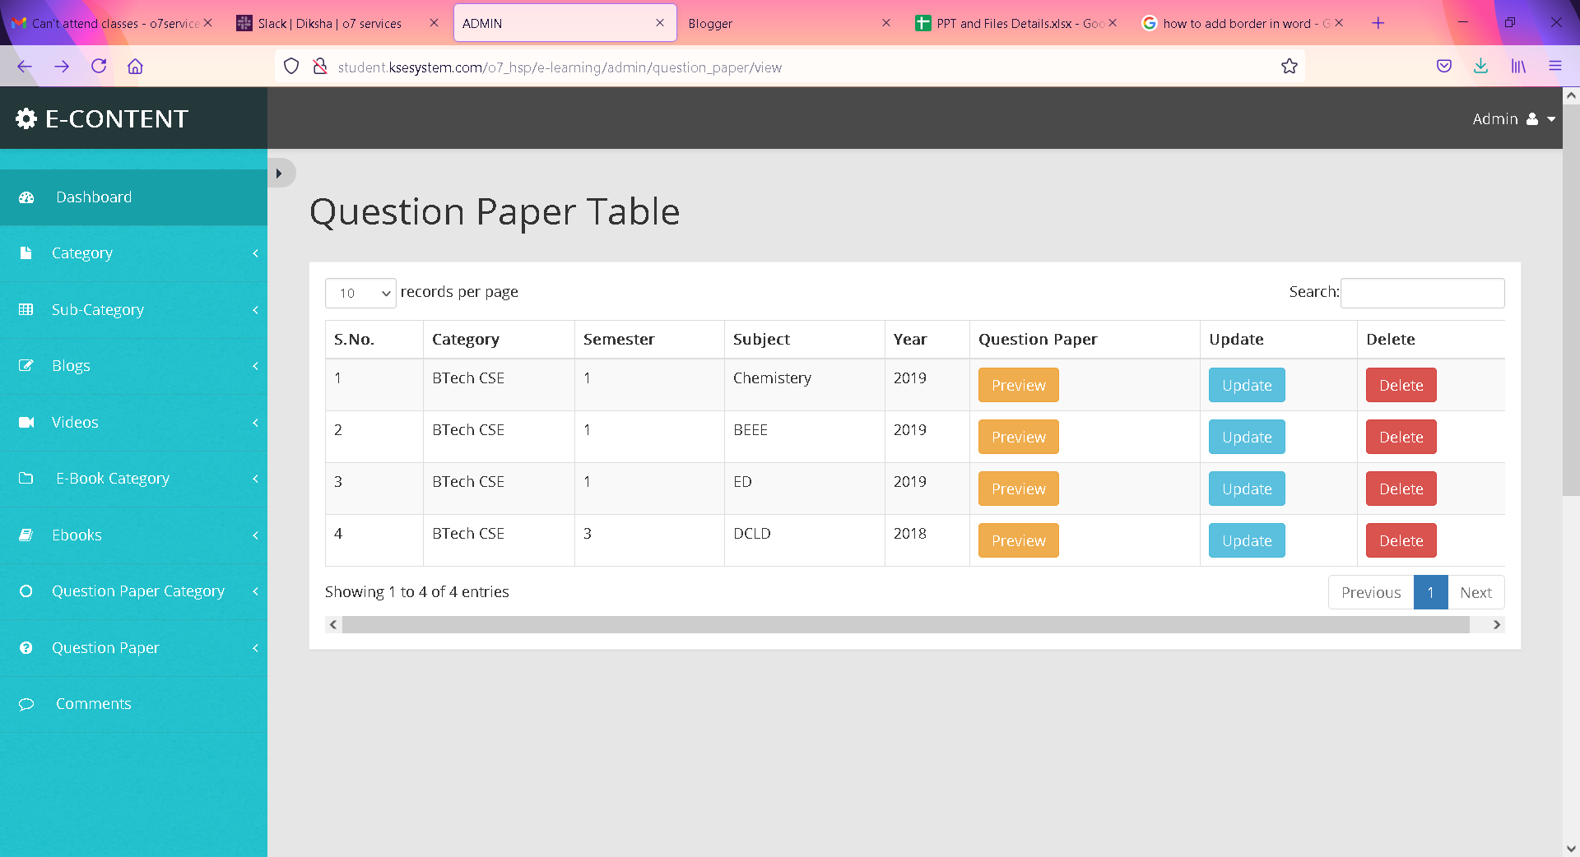
VIEW QUESTION PAPER

Slide 31
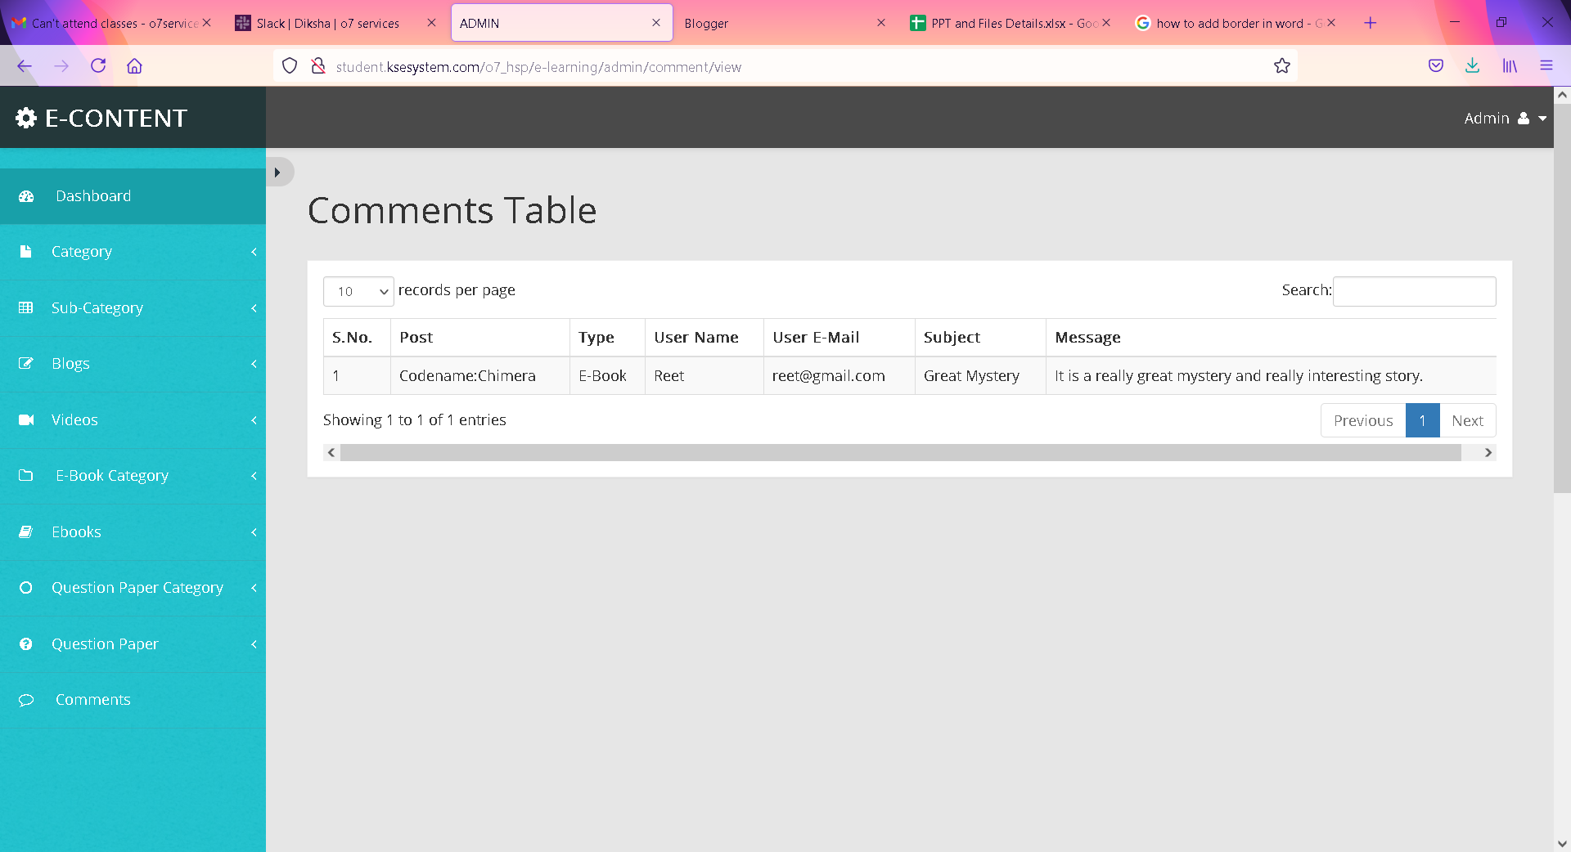
COMMENTS TABLE

Slide 32
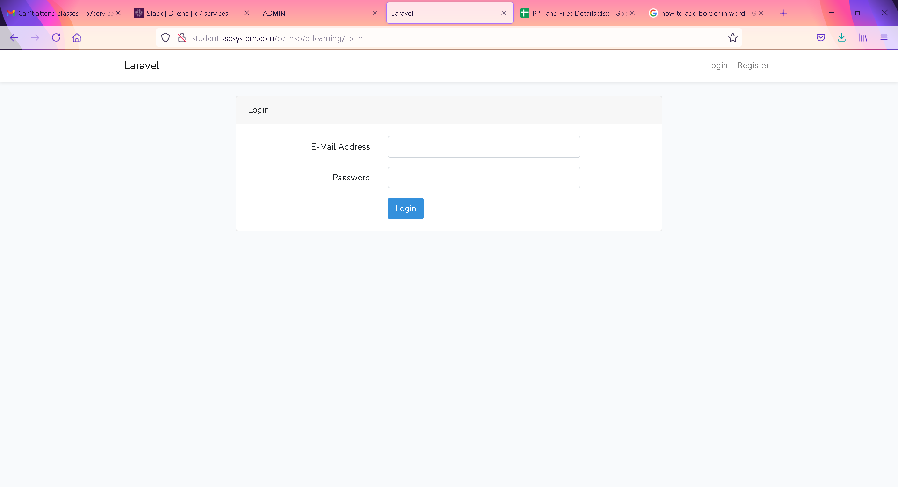
USER SIDE USER LOGIN PAGE

Slide 33

USER HOME PAGE

Slide 34
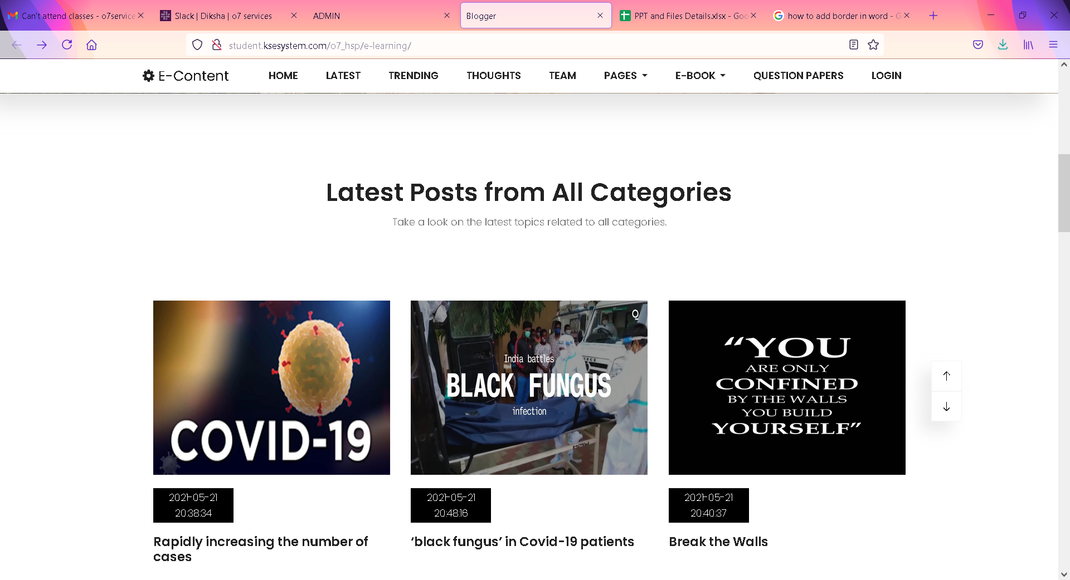
LATEST PAGE

Slide 35
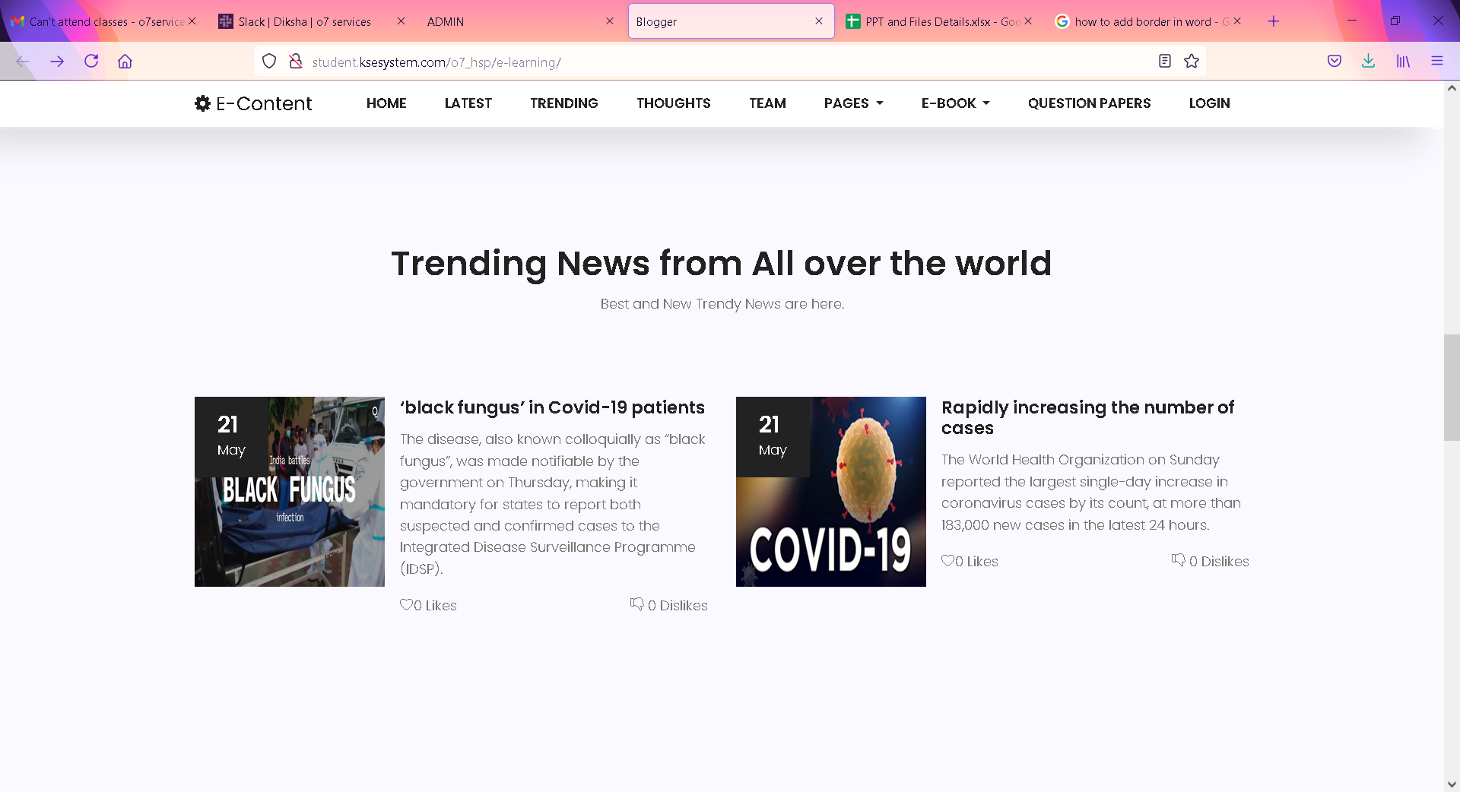
TRENDING PAGE

Slide 36
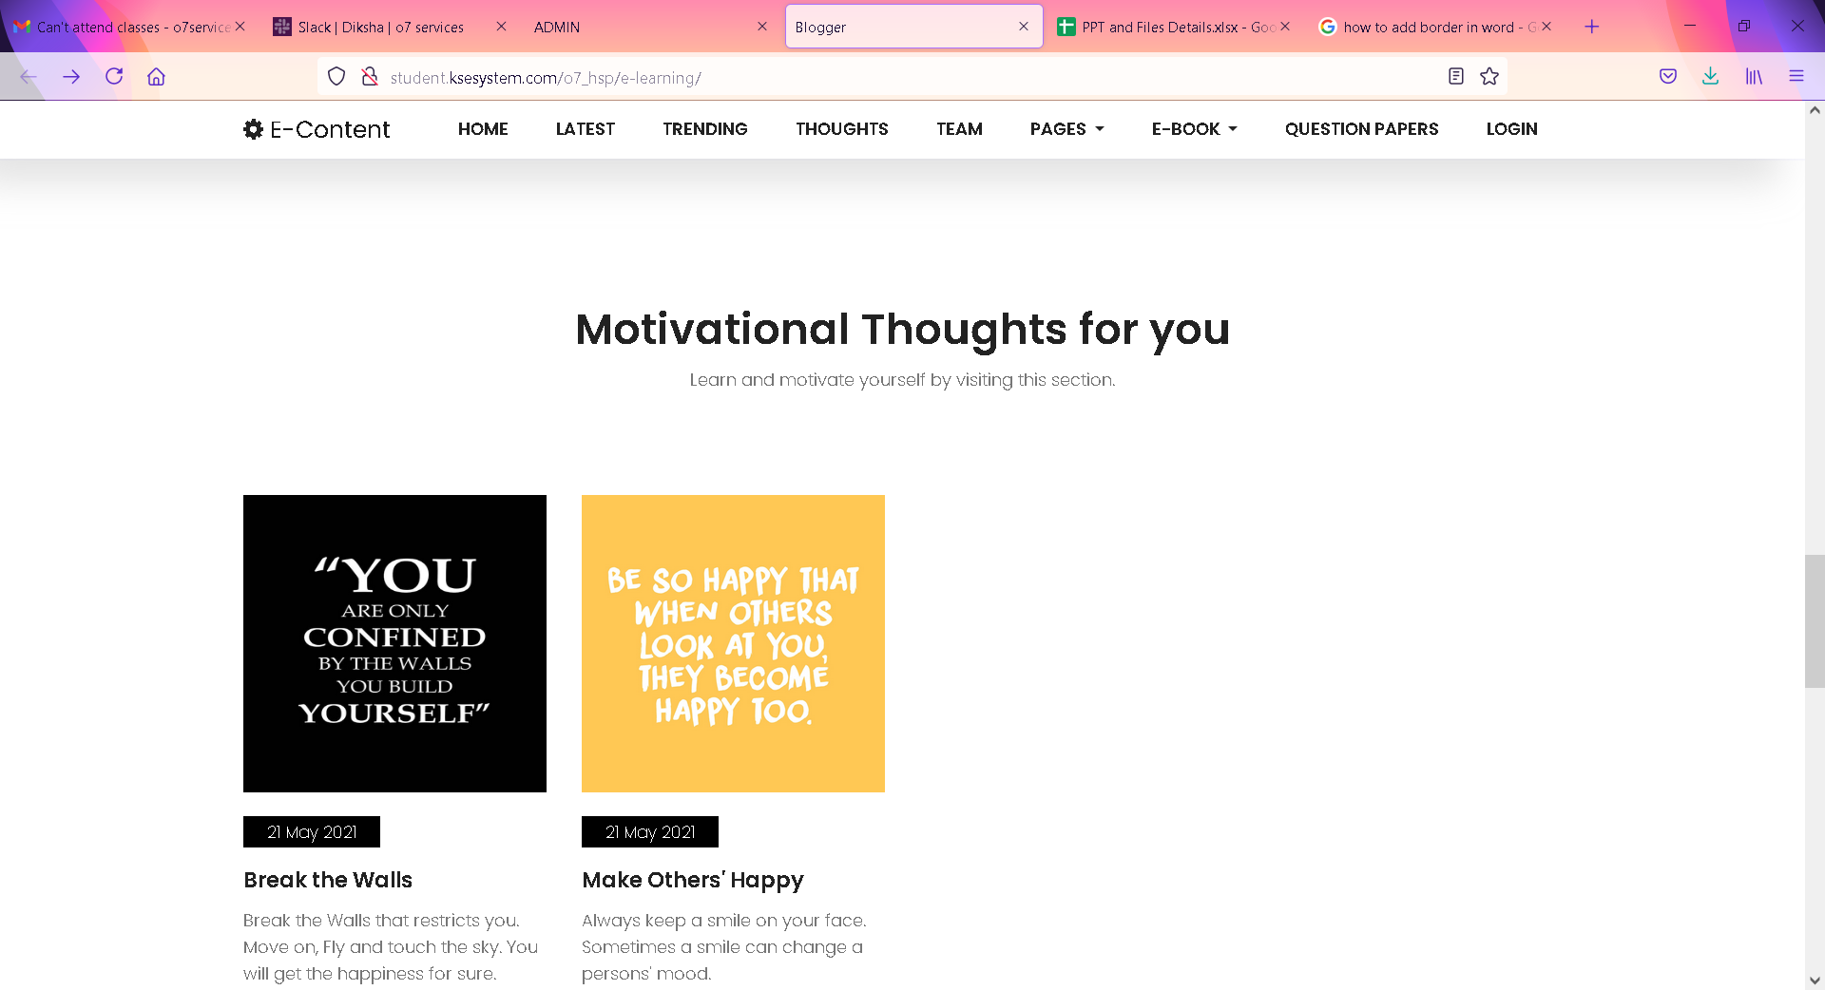
THOUGHTS PAGE

Slide 37

BLOGGER TEAM PAGE

Slide 38
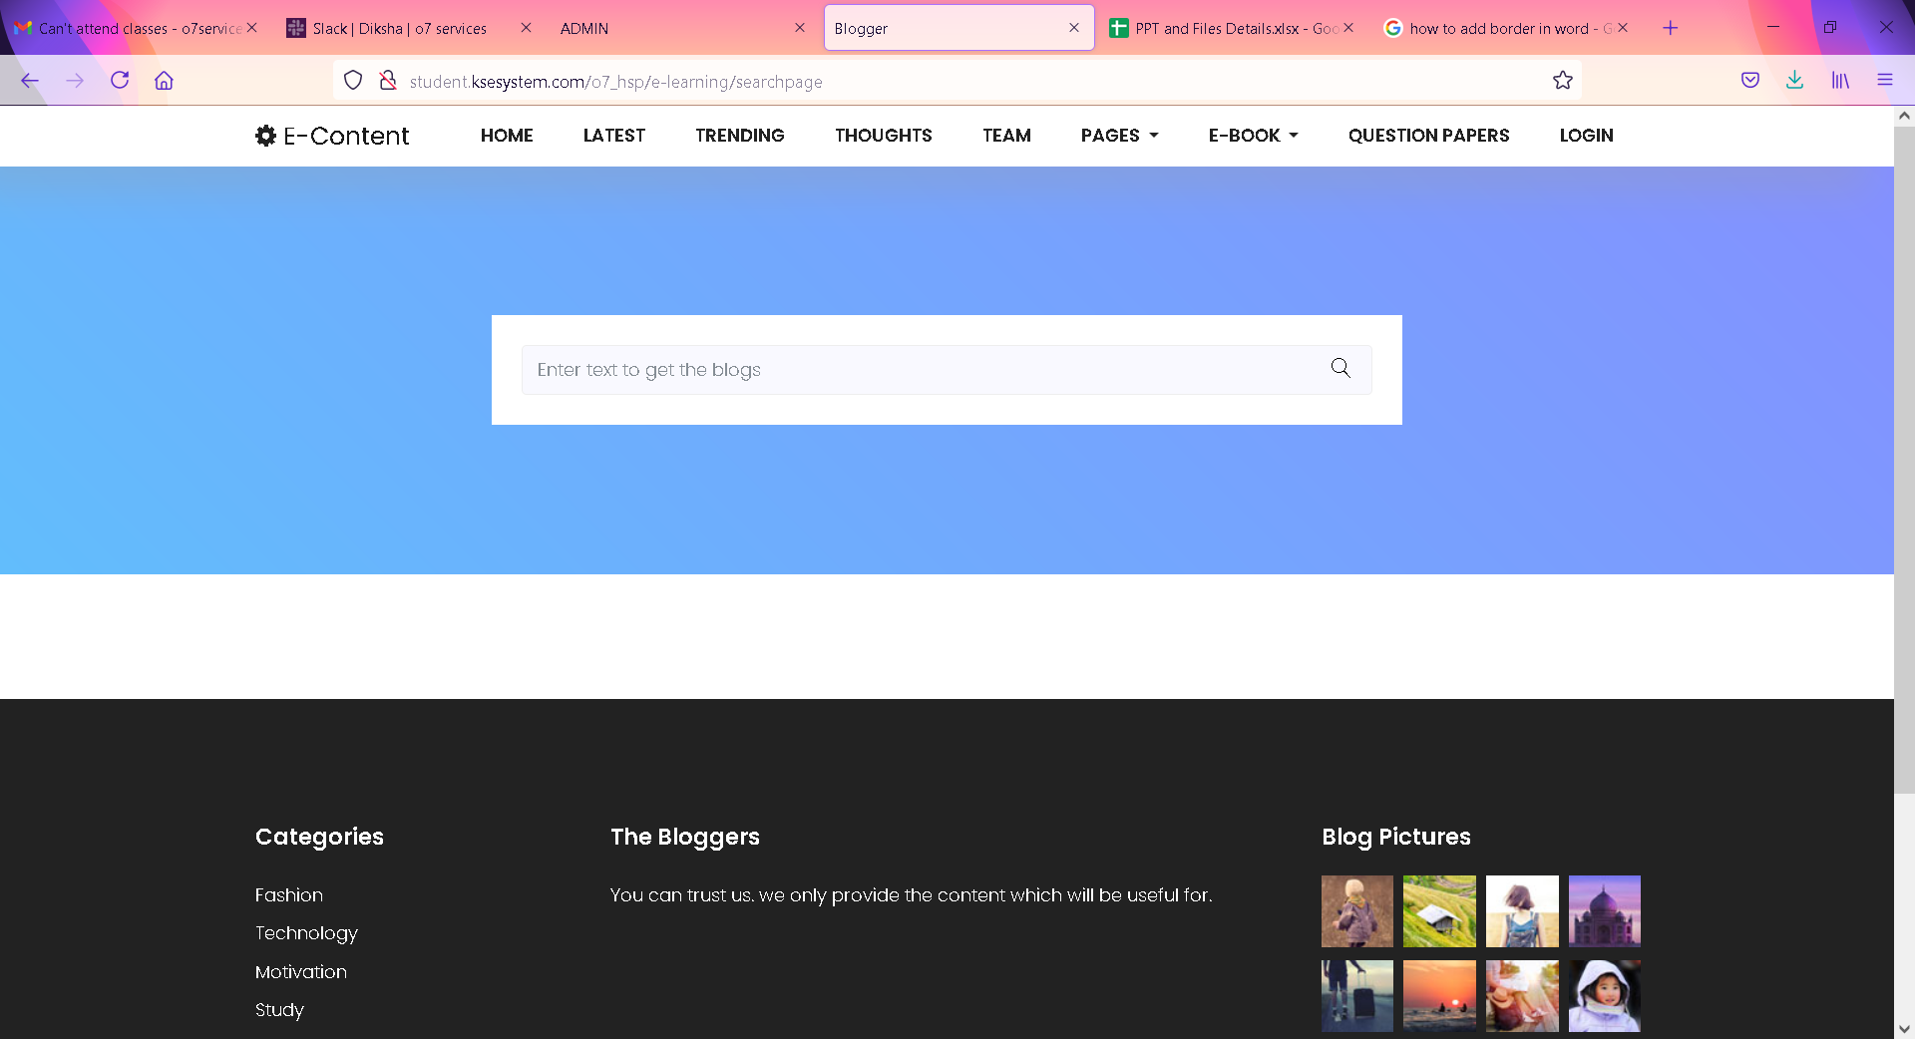
SEARCH pAGE

Slide 39
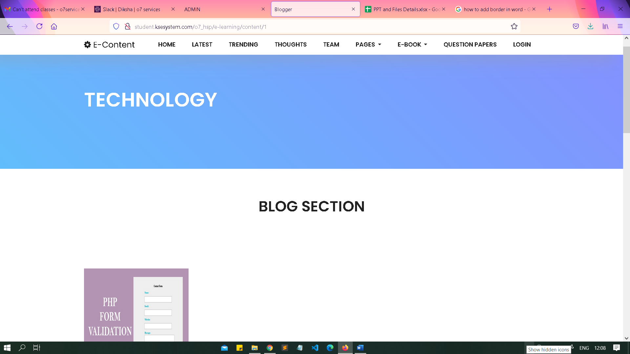
TECHNOLOGY PAGE

Slide 40
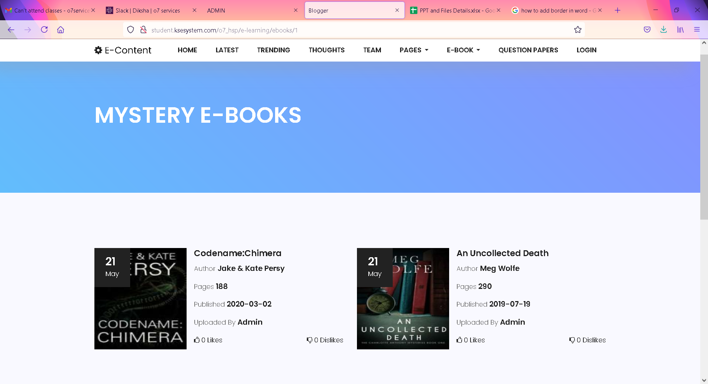
MYSTERY E-BOOKS

Slide 41
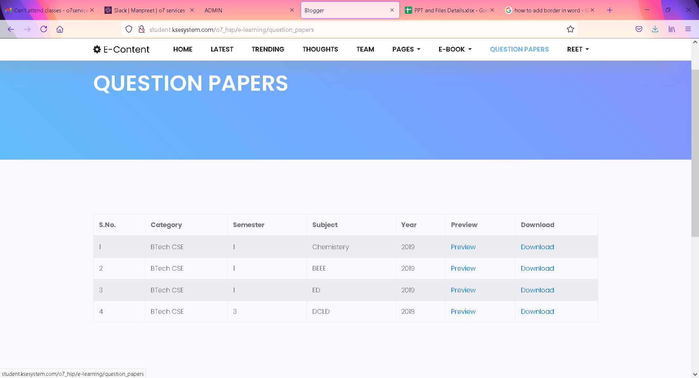
QUESTION PAPERS

Slide 42
FACILITIES REQUIRED FOR PROPOSED WORK
Hardware Requirement:
Hardware - intel core i3
RAM - 4GB
Hard disk - 20GB
Software Requirements:
Operating System : Windows
Technology : PHP
Web Technologies : Html, JavaScript, CSS
IDE : Sublime
Web Server : XAMPP
Database : MySQLi

Slide 43
CONCLUSION
E-Learning is a learning process with the combination of content that is both delivered digitally and through face-to-face learning.
eLearning contributes to the shifts from traditional face-to-face learning to the use of web technological tools
E-Learning enhances collaborative learning and presents an entirely new learning platform for students.
Enhance the quality of learning and teaching
Improve user-accessibility and time flexibility to engage learners in the learning process

Slide 44
BIBLIOGRAPHY
http://www.google.com
http://www.w3schools.com
http://www.codeproject.com
http://www.tutorialspoint.com

Slide 45
THANK YOU

